Slide 1
ArangoDB
Lecturer: Ngo Huy Bien
Software Engineering Department
Faculty of Information Technology
VNUHCM - University of Science
Ho Chi Minh City, Vietnam
nhbien@fit.hcmus.edu.vn

Slide 2

Objectives

Slide 3

Contents

Slide 4

References

Slide 5
ArangoDB
https://www.arangodb.com/
Natively store data for graph, document and search needs.
Utilize feature-rich access with one query language.

Slide 6
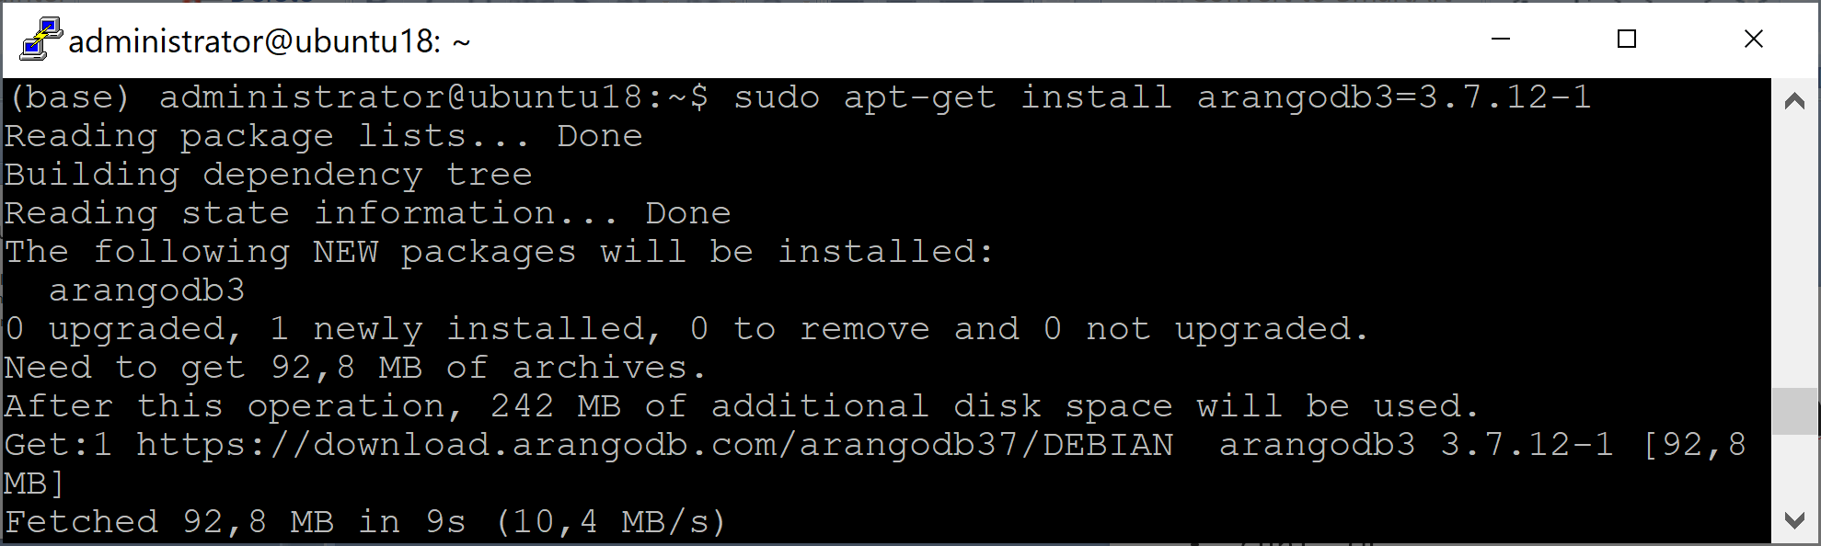
1. Install ArangoDB
curl -OL https://download.arangodb.com/arangodb37/DEBIAN/Release.key
sudo apt-key add - < Release.key
echo 'deb https://download.arangodb.com/arangodb37/DEBIAN/ /' | sudo tee /etc/apt/sources.list.d/arangodb.list
sudo apt-get install apt-transport-https
sudo apt-get update
sudo apt-get install arangodb3=3.7.12-1

Slide 7
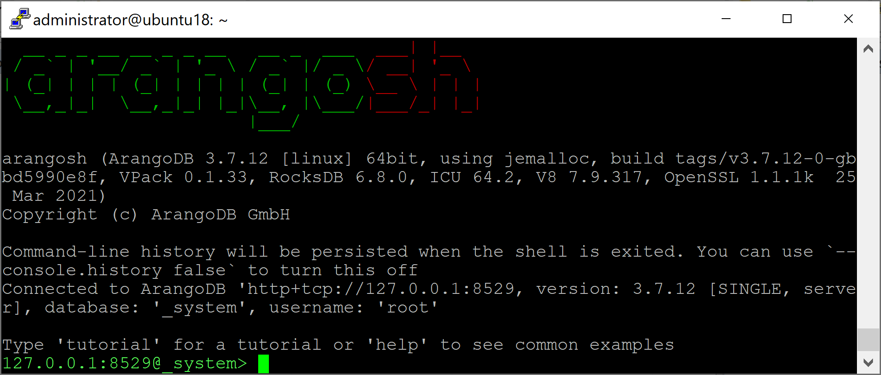
2. Test ArangoDB
sudo systemctl disable arangodb3 (Disable the service from starting automatically)
sudo systemctl status arangodb3
sudo systemctl start arangodb3
arangosh

Slide 8
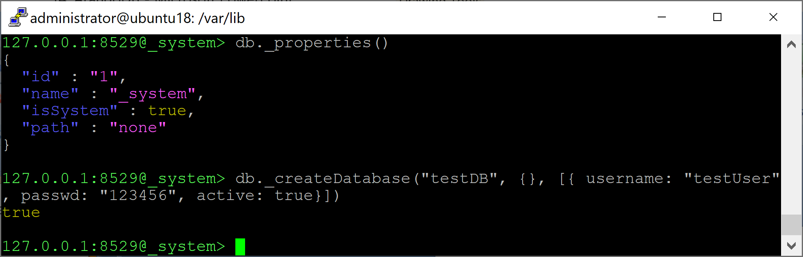
3. Work with Databases
https://www.arangodb.com/docs/stable/data-modeling-databases-working-with.html
require("@arangodb").db._name();
db._properties()
db._createDatabase("testDB", {}, [{ username: "testUser", passwd: "123456", active: true}])

Slide 9
4. Change ArangoDB Data Location
mkdir /data/arangodb3
sudo chmod 700 /data/arangodb3/
sudo chown -R arangodb:arangodb /data/arangodb3/
sudo nano /etc/arangodb3/arangod.conf
[database]
# directory = /var/lib/arangodb3
directory = /data/arangodb3
sudo systemctl restart arangodb3
sudo systemctl status arangodb3
arangosh (empty password)

Slide 10
5. Change Root Password
https://www.arangodb.com/docs/stable/security-change-root-password.html
sudo nano /etc/arangodb3/arangod.conf
authentication = false
sudo systemctl restart arangodb3
sudo systemctl status arangodb3
arangosh
require("org/arangodb/users").update("root", "Localpw@1234");

Slide 11
6. Change Server Endpoint
sudo nano /etc/arangodb3/arangod.conf
endpoint = tcp://0.0.0.0:8529
sudo systemctl restart arangodb3
sudo systemctl status arangodb3
arangosh --server.endpoint tcp://192.168.1.19:8529 --server.username root
http://192.168.1.19:8529/ (root / Localpw@1234)

Slide 12
7. Start a Server
sudo systemctl status arangodb3
sudo arangod --server.endpoint tcp://0.0.0.0:8529 --database.directory /data/arangodb3
sudo nohup arangod --server.endpoint tcp://0.0.0.0:8529 --database.directory /data/arangodb3 > arangodb.log &
If a command is terminated by the control operator ( '&' ), the shell shall execute the command asynchronously in a subshell. This means that the shell shall not wait for the command to finish before executing the next command.
sudo kill 3815

Slide 13


Slide 14
1. Create Authentication Token
https://www.arangodb.com/docs/stable/programs-starter-security.html
arangodb create jwt-secret --secret=arangodb-secret.jwt
sudo mv ./arangodb-secret.jwt /etc/arangodb-secret.jwt

Slide 15
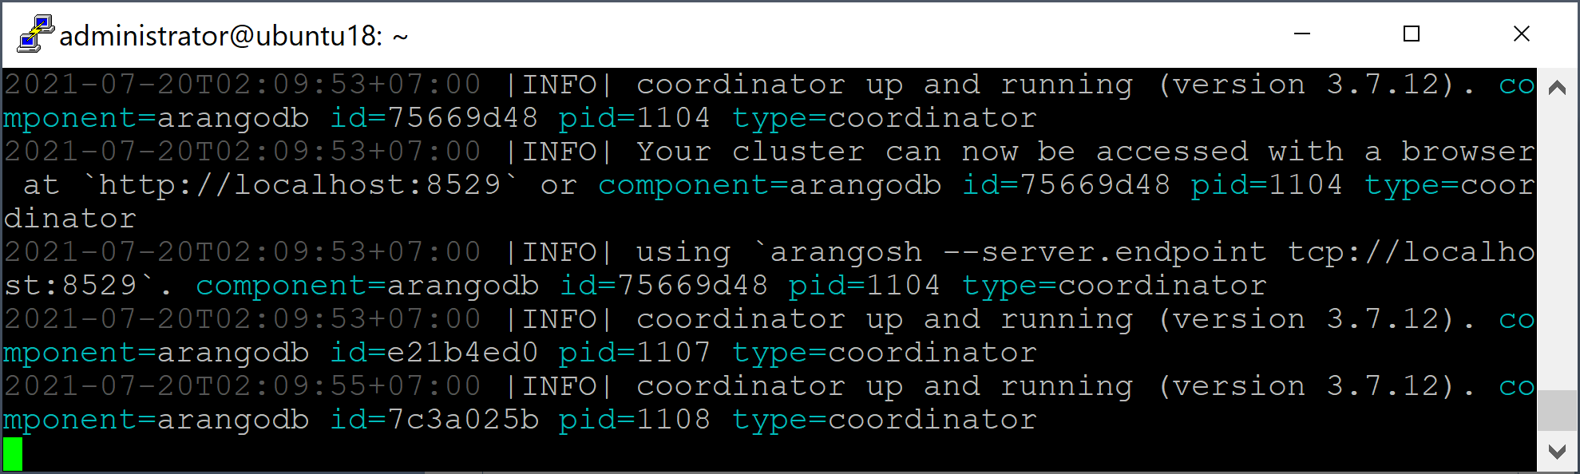
2. Local Tests
https://www.arangodb.com/docs/stable/deployment-cluster-using-the-starter.html
sudo systemctl stop arangodb3
sudo systemctl disable arangodb3
sudo arangodb --starter.local --starter.data-dir=/data/arangodb3 --auth.jwt-secret=/etc/arangodb-secret.jwt

Slide 16
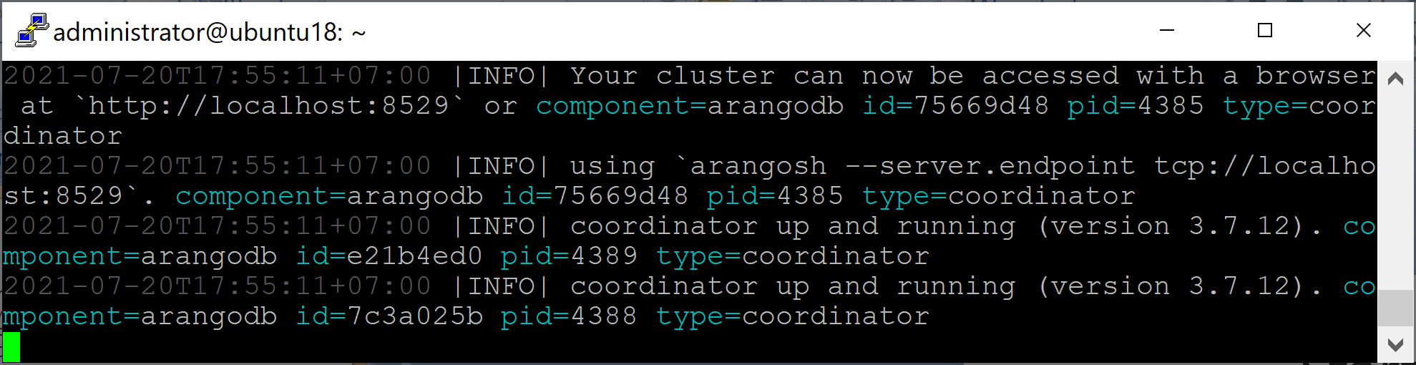
3. Start a Cluster
sudo arangodb --server.storage-engine=rocksdb --auth.jwt-secret=/etc/arangodb-secret.jwt --starter.data-dir=/data/arangodb3 --starter.join 192.168.1.19,192.168.1.18
http://192.168.1.19:8529/

Slide 17

Thank You & See You Again

